Slide 1
Zapanuj nad przepływem swoich danych z
Azure Data Factory
Katowice 2018.11.28
Author:
Tomasz Krawczyk
Notes:
Nazywam sie TK –aktualnie wsplpracuje z firma FP w takiej komorce ktora nazywa sie Data Solution
– jak moje córki pyta co robie to mowie ze bawie sie chmura a dokladaniej zajmuje sie przetwarzaniem duzych zbiorow danych w chmurze Azure
Dzis chcialbym Wam odpowiedziec o jdenych z moim zabawek – generlanie to chcialbym odpowiedziec jak ja zaczynalem swoja przygotoge z Big Data,

Slide 2
Agenda
Data Processing ETL vs ELT – quick overview
Azure Data Factory – overview
Pipeline, Actions, Linked Services
Real scenarios
Demo
Q&A
Notes:
I my zeby tak gwaltownie niezaczac

Slide 3
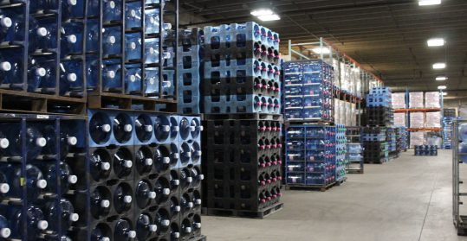

Data Processing
ETL (Extract Transform Load) - Schema On-Write
Data Warehouse
ELT (Extract Load Transform) - Schema On-Read
Data Lake
Source: https://premiumwaters.com
What is Data Lake ?
“If you think of a datamart (a subset of a data warehouse) as a store of bottled water – cleansed and packaged and structured for easy consumption – the data lake is a large body of water in a more natural state„
Pentaho CTO James Dixon
I(ngest) S(tore) A(nalyse) S(urface) A(ct)
Source :https://snowbrains.com
Notes:
For the last couple of decades ETL (extract, transform, load) has been the traditional approach for data warehousing and analytics. The ELT (extract, load, transform) approach changes the old paradigm. But, what’s actually happening when the “T” and “L” are switched?

Slide 4

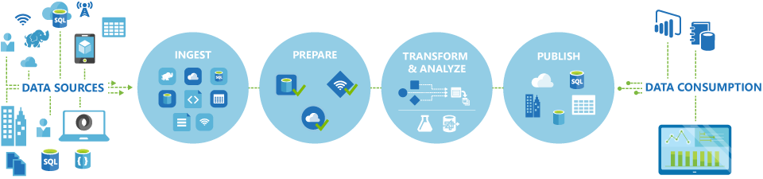
Azure Data Factory
Fully managed service to support orchestration of data movement and transformation
Connect to relational or non-relational data that is on-premises or in the cloud
Allows monitor and manage data processing pipelines

Slide 5
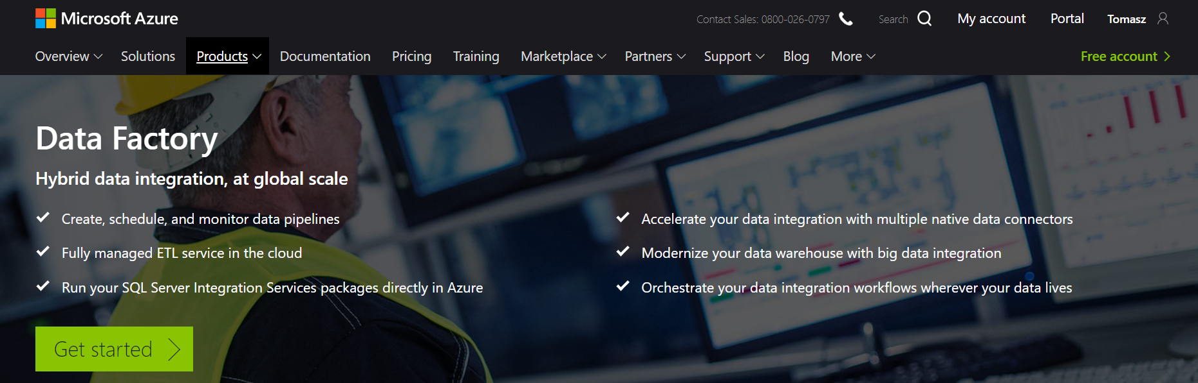
Azure Data Factory (V2)
https://azure.microsoft.com/en-us/services/data-factory/
Notes:
Fully managed service to support orchestration of data movement and transformation
Connect to relational or non-relational data that is on-premises or in the cloud
Allows monitor and manage data processing pipelines
Version 1 and 2 (+SSIS)

Slide 6
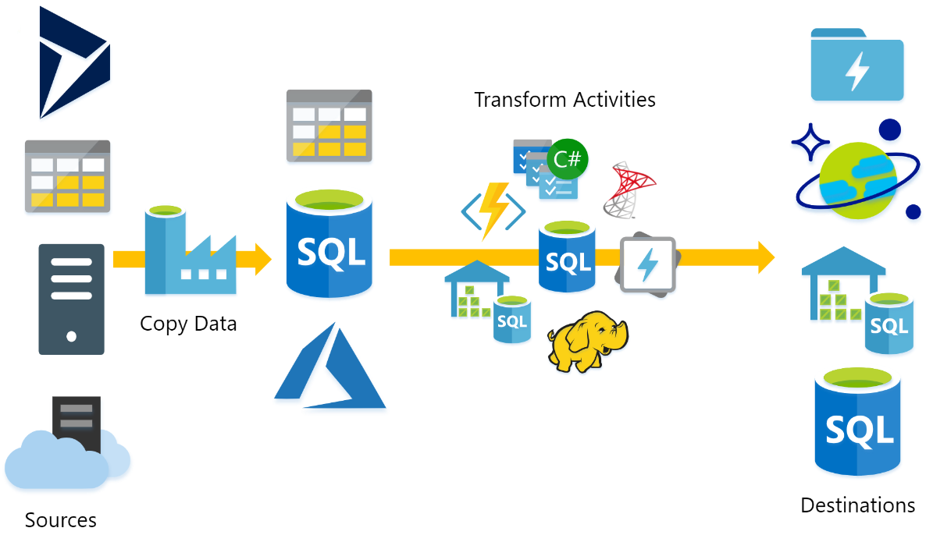
What does ADF do?
Source : P.Andrew

Slide 7

Azure Data Factory Concept
Dataset
(eg. tables, files)
Activity
(eg. Copy, Hive job,
SP, ADLA job)
Pipeline
(schedule,monitor,
manage)
Consumes
Is a
logical
grouping of
Produces
Represents
data item(s)
stored in
Runs on
Linked Services
(eg. SQL Server,
HDInsight,ADLA)
Triggers
Notes:
Activities
Actions you perform on your data
Inputs turned into outputs
Pipelines
Logical grouping of activities for group operations
Data sets
A named reference/pointer to data you want to use as an input or output of an activity
Linked services
Connection of data factories to the resources and services you want to use
Connection of data stores like Azure storage and on-premises SQL Server
Connection of compute services like Azure Machine Learning, Azure HDInsight, and Azure Batch

Slide 8
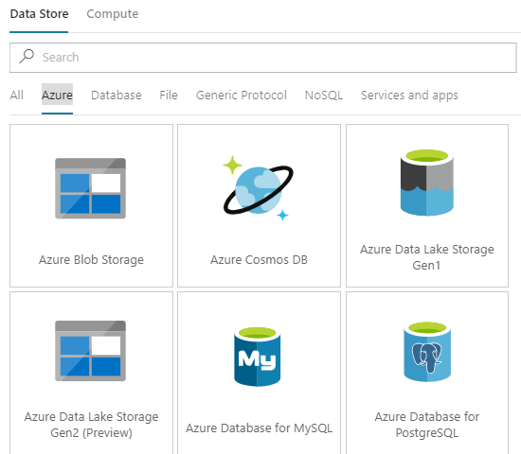
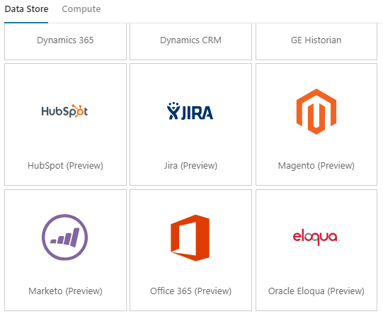
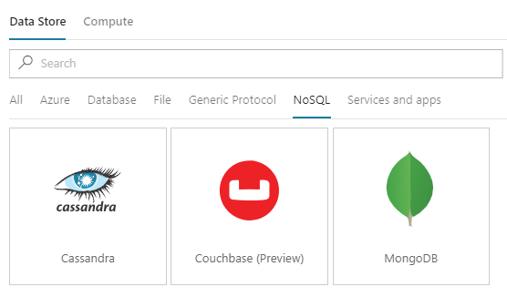
Azure Data Factory – Linked Services
More than 70 connectors

Slide 9
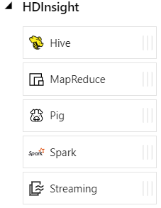
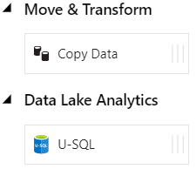
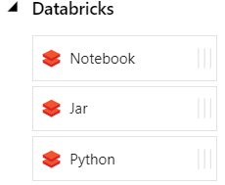
Azure Data Factory - Data activities
Data movement activities : Copy Activity
Data transformation activities :
HDInsight (Hive, Pig, MapReduce ,Hadoop Streaming ,Spark)
Databricks Notebooks (V2)
Machine Learning activities: Batch Execution and Update Resource (*)
Stored Procedure
Data Lake Analytics U-SQL
DotNet (Custom)

Slide 10
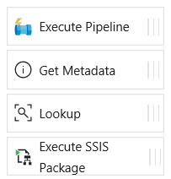
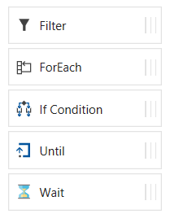
Azure Data Factory - Control flow activities
Execute Pipeline Activity
ForEach Activity
Web Activity
Lookup Activity
Get Metadata Activity
Until Activity
If Condition Activity
Wait Activity

Slide 11
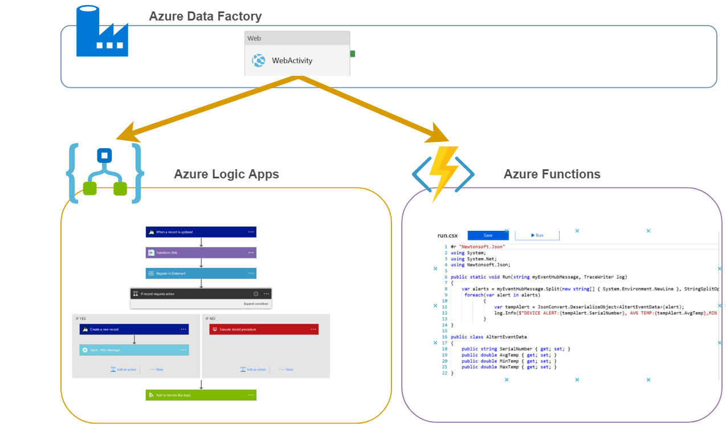
Azure Data Factory – Web Activity
Rest API Calls

Slide 12
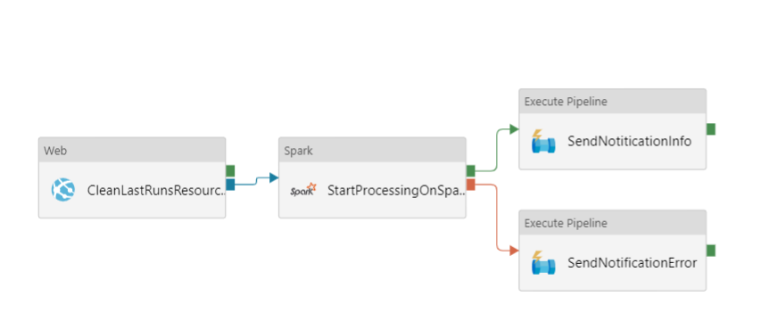
Azure Data Factory – Web Activity Example

Slide 13
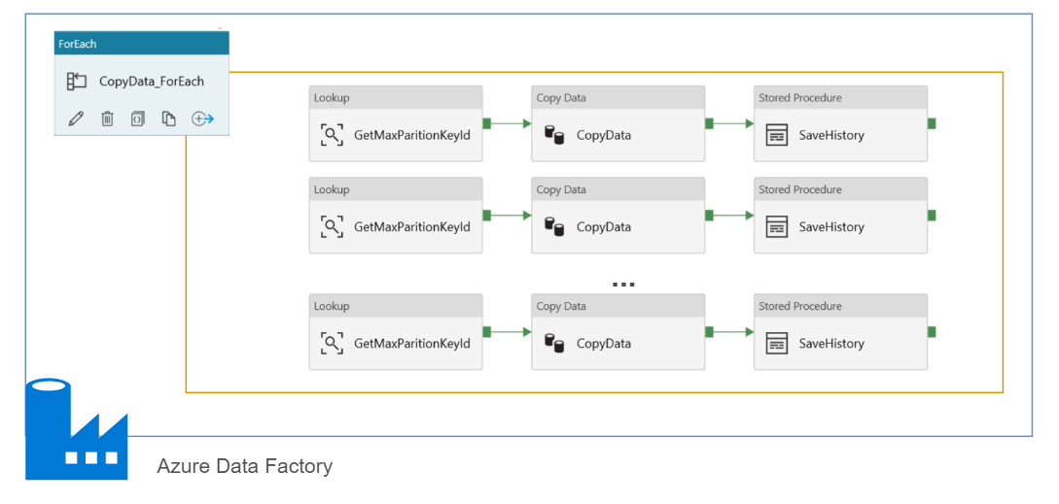
Azure Data Factory – ForEach
Max 20 DOP

Slide 14
Azure Data Factory – What else ?
Parameters
Expressions
Dynamic Content
Functions
Branching
On success
On failure
On completion
Activity 2
On success
Activity 1
(eg. Copy, Hive job,
SP, ADLA job)
Activity 3
On completion
On failure
Activity 4

Slide 15
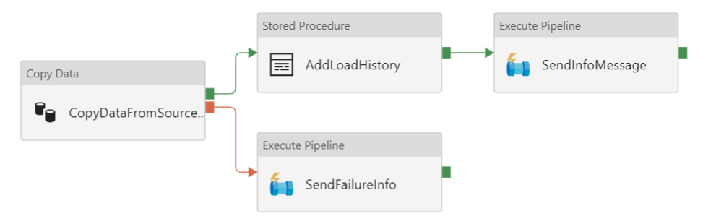
Azure Data Factory –Branching

Slide 16
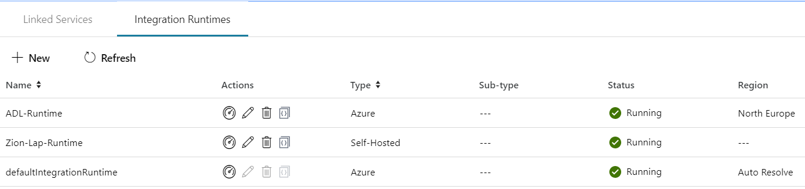
Integration runtime(s) in Azure Data Factory
The Integration Runtime (IR) is the compute infrastructure used by Azure Data Factory to provide the following data integration capabilities across different network environments
Integration runtime types:
Azure (Data movement and activity on Azure)
Self-hosted (Data movement and activity dispatch between public and private network)
Azure-SSIS (SSIS package execution)

Slide 17

Self Hosted Integration runtime
Now called Self Hosted Integration Runtime
Before Data Management Gateway
One version for ADF V1 and V2
SSL Port : 443
One to Many

Slide 18

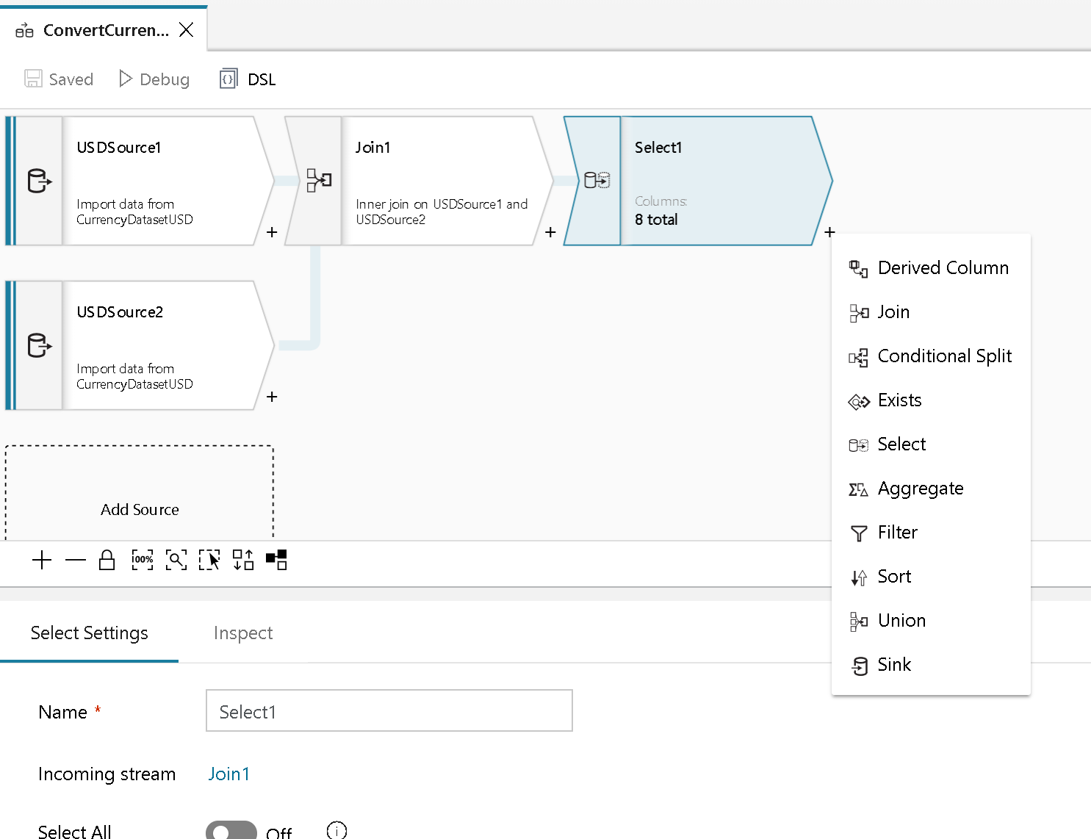
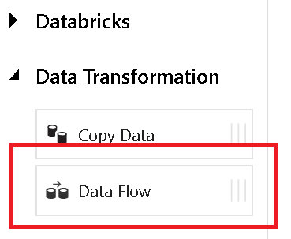
Azure Data Factory- DataFlow (Preview)
+
Azure Data Factory
Azure Databricks

Slide 19
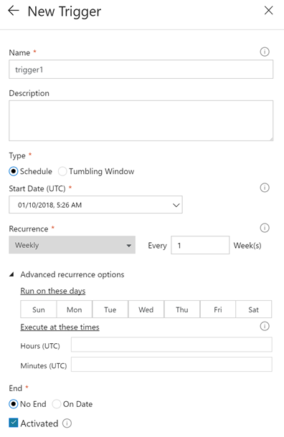
Pipeline execution and triggers in Azure Data Factory
Manual execution (on-demand)
The REST API
The .NET SDK
Trigger execution
Schedule trigger
Tumbling window trigger

Slide 20
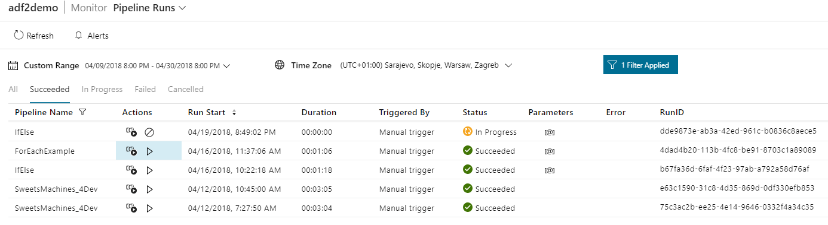
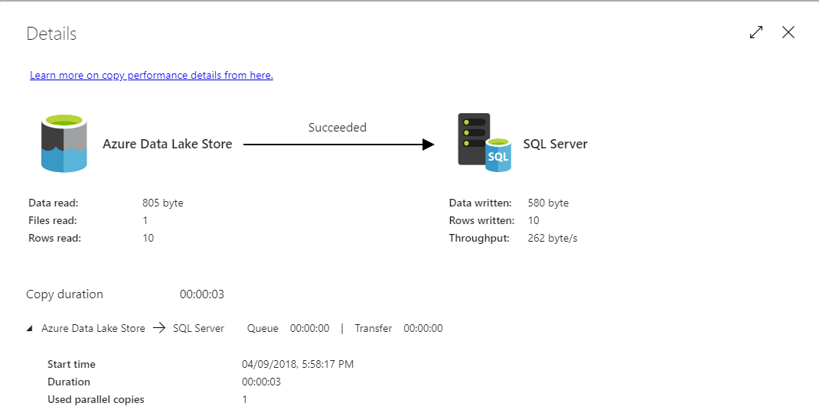
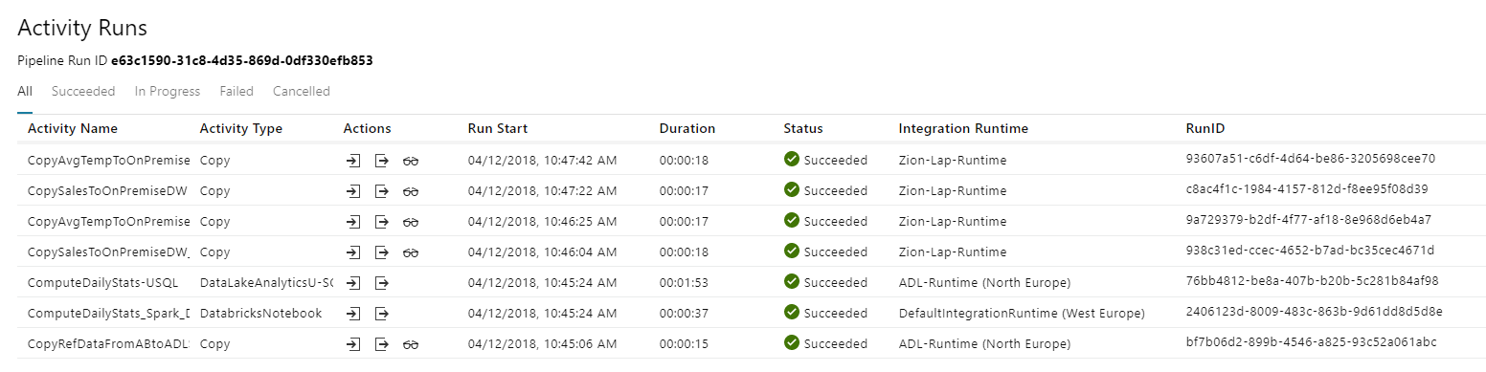
Azure Data Factory Monitoring

Slide 21
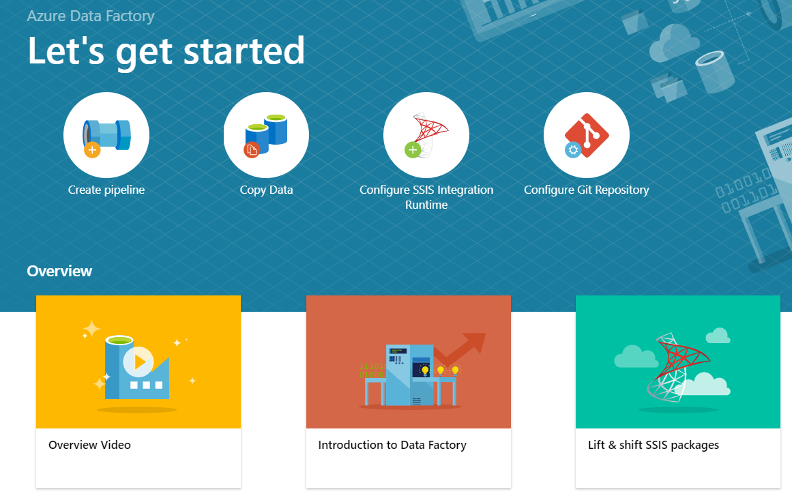
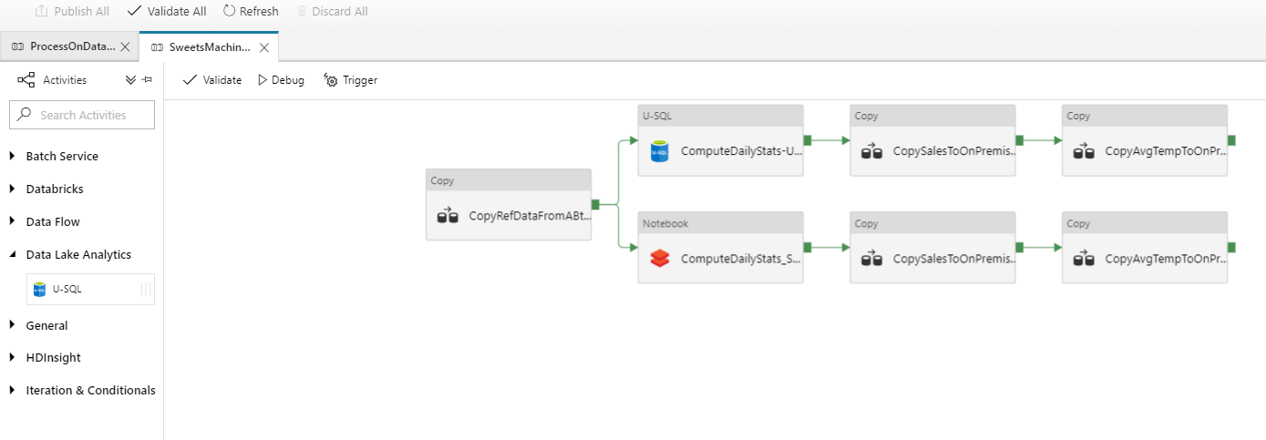
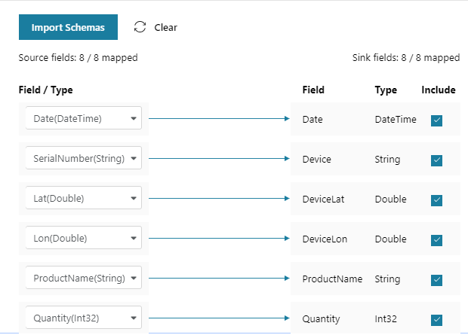
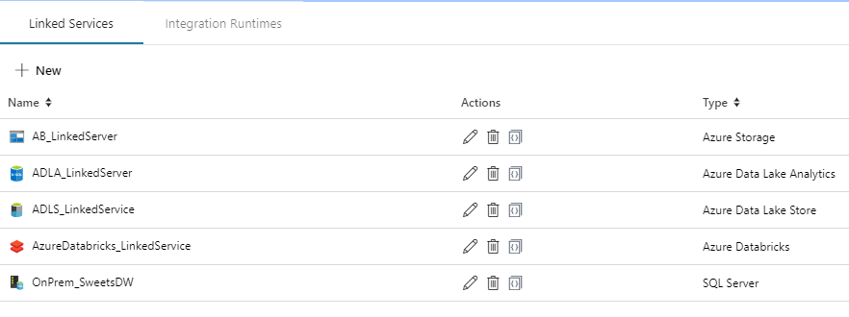
Azure Data FactoryTools
ADF V2 Web Designer (Azure Portal)

Slide 22
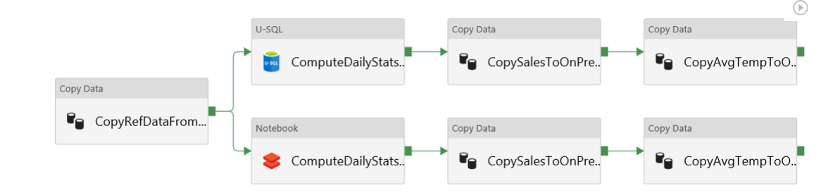
Azure Data Factory – Sample Pipeline

Slide 23
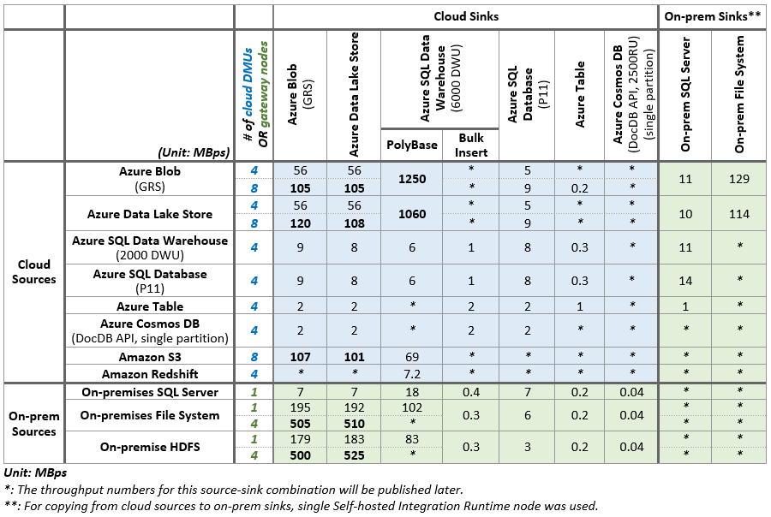
Azure Data Factory Performance
https://docs.microsoft.com/en-us/azure/data-factory/copy-activity-performance

Slide 24
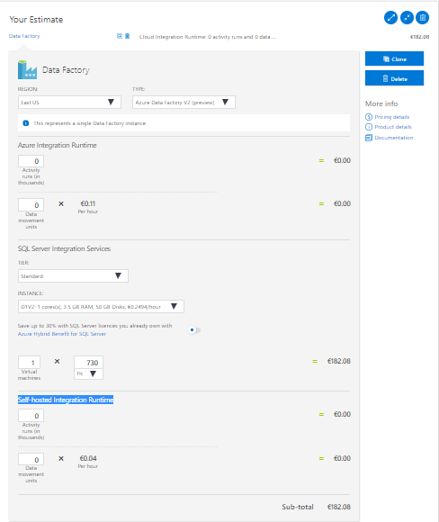
Azure Data Factory Costs
Costs depend on Integration Runtime:
Azure Integration Runtime
Activity runs (in thousands)
Data movement units
Self-hosted Integration Runtime
Activity runs (in thousands)
Data movement units
SQL Server Integration Services
Virtual machine(s) type e.g. D1V2 (h)
https://azure.microsoft.com/en-gb/pricing/calculator/

Slide 25
DEMO

Slide 26
Q & A

Slide 27
Resources
My examples (and demos)
https://github.com/cloud4yourdata/demos/tree/master/4DevKatowice2018/USQL
https://github.com/cloud4yourdata/usql/
Blogs and pages
http://aka.ms/AzureDataLake
http://usql.io
http://blogs.msdn.microsoft.com/mrys/
http://blogs.msdn.microsoft.com/azuredatalake/
Documentation, articles ...
http://aka.ms/usql_reference
https://azure.microsoft.com/enus/documentation/services/data-lake-analytics/
https://msdn.microsoft.com/en-us/magazine/mt614251
https://channel9.msdn.com/Search?term=U-SQL#ch9Search
https://www.youtube.com/results?search_query=U-SQL

Slide 28
THANK YOU!
tkrawczyk@future-processing.com

